Slide 1
The Agile Core
A Module in Agile Fundamentals
Notes:
Hello, and welcome to The Agile Core, a module in Agile Fundamentals. This module is brought to you by ThoughtWorks Studios, makers of Mingle, Cruise, and Twist.
In this module, we will talk about some of the core concepts that make Agile what it is. Rather than talk about software, we’re going to talk about Bill…
NEXT SLIDE
The Agile Core: Story Based Development & Incremental Business Value
User Stories, Use Cases and Scenarios
Looking at the Big Picture – Is up front planning OK?
“Good Enough” Software
Release Early and Often
The story:
Actors and use cases – sterile
Actors are causal, use cases state results of that causality
Use cases are explanatory, and rarely include business value
Storytellers, customers, and stories – comes alive
Roles represent
Stories are demanding, as well as explanatory
Stories tell you why, as well as what
Stories do NOT tell you HOW
Storytellers share experience and needs
The Big Picture – is it possible to know everything up front?
has anyone had a house built? Remodeling done?
Zeno’s Paradox of the Dichotomy
http://en.wikipedia.org/wiki/Zeno%27s_paradoxes#The_dichotomy_paradox
“That which is in locomotion must arrive at the half-way stage before it arrives at the goal.” ~Aristotle, Physics VI:9, 239b10
“The perfect is the enemy of the good.” ~Voltaire
Incremental, with constant review
Fail fast, learn quickly, adapt - PDCA

Slide 2
Agile Core Principles
Notes:
There are 12 principles that support the 4 Agile Manifesto value statements.
Let’s talk through them and the practices that support them.

Slide 3
Principles Behind the Agile Manifesto
Satisfy the customer through early delivery of valuable software
Harness changes in requirements for a competitive advantage
Deliver working software frequently
Business and development work together daily
Support and trust the team
Face-to-face conversations are best
Working software is the primary measure of progress
Sustainable pace of development
Continuous attention to technical excellence
Simplicity is essential
Architecture and design emerge from the team
Reflect on the process and improve it
Notes:
The 12 principles behind the agile manifesto. Key points:
Business value
Deliver frequently
Teamwork and collaboration
These are woven through the fabric of these principles
Now let’s take a look at some of these, and how they can apply here (to the workshop attendees)

Slide 4
Business Value
Notes:
Our highest priority is to satisfy the customer through early and continuous delivery of valuable software

Slide 5
Time to Value
+
Value
Agile
Traditional
-
Time

Slide 6
Value statement
Role: As a …
Goal: I want/need …
Value: So that …
Notes:
We put a value statement in each story.

Slide 7
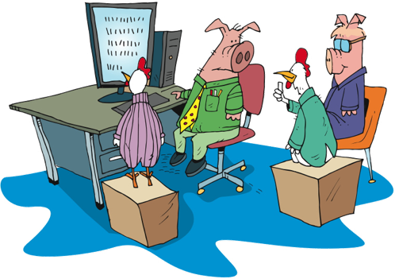
Feedback
Scenarios
Showcases
Play environment
Notes:
To insure we are always delivering business value, we:
Define Scenarios based on business usage
Showcase work often to get the feedback
Provide an environment for folks to ‘test the tires’. Run through their work. Scenarios.

Slide 8
Adaptive Planning
Notes:
Welcome changing requirements, even late in development. Agile processes harness change for the customer’s competitive advantage.

Slide 9
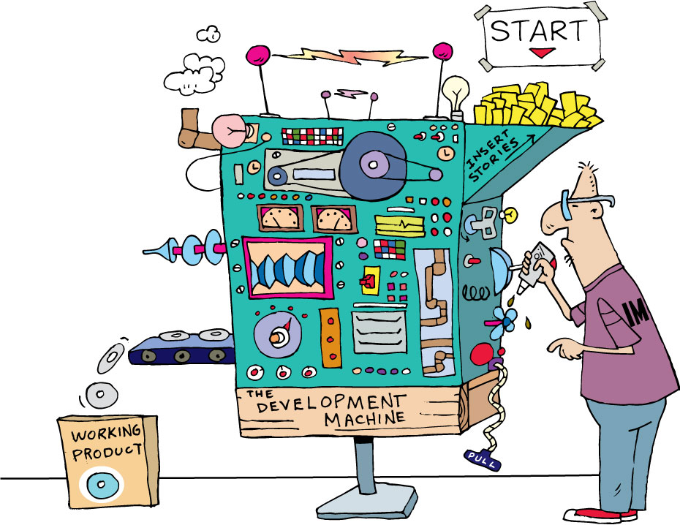
Release and Iteration Planning
Release Planning
Iteration Planning
Release
Success
Criteria
Estimated
Story
Backlog
Estimated
Story
Backlog
Iteration
Success
Criteria
Development Capacity (Velocity)
Release
Constraints
Iteration
Constraints
Release Planning
Development Capacity (Velocity)
Release Planning
Feedback
Feedback
Notes:
Release planning feed iteration planning with new stories or planned stories
Iteration planning feeds the iteration with the actual stories you will work on.
The iteration feeds back to Release Planning with feedback stories or defects.
The iteration feeds Iteration Planning with feedback stories or defects or changes to process.

Slide 10
Iteration planning: input
Development Capacity (Velocity)
Release Plan
Prioritized Story Backlog
Story owners/Domain Knowledge
Iteration Theme
Original stories
New stories
Defects
Hangover stories
Stories
Capacity
Theme
Iteration
Planning
Notes:
Planning for the next immediate iteration should be detailed and may even pre-task out stories.
Rolling look ahead planning – Mike Cohn – looks out 3+ iterations. Planning for cross team dependencies, distributed dependencies, etc.
Iterations should not change once started. Wondering about this bullet?
Stories can be pulled in if all work is complete, but stories should not be changed mid iteration.

Slide 11
Frequent Releases
Notes:
Deliver working software frequently, from a couple of weeks to a couple of months with a preference to the shorter timescales.
Working software.
Minimal marketable feature set
Minimal viable product

Slide 12
Working software
Notes:
Not just releasing to LIVE.
After each iteration.
Not necessarily releasable.

Slide 13
High-level Release Plan
Today
Jan 2014
Risk Expiry
Sep 2014 Risk Expiry
2014
15 Apr Service Required
15 July Service Required
3 Nov Service Required
1 Feb Release
2 May Release
11 Aug Release
2 Sep Release
2 Nov Release
RAID
Development Goal
Delivery Constraint
Notes:
Do you release often here? Do you ever go beyond release 1, or do you do the “big bang” thing?

Slide 14
Collaboration
Notes:
This crosses many boundaries. Let’s discuss.

Slide 15

On-site Customer
Product Owner/Business is “us” not “them”
Product Owner/Business is equally committed to the process
Product Owner/Business is the final arbiter
Notes:
Business people and developers must work together daily throughout the project.

Slide 16
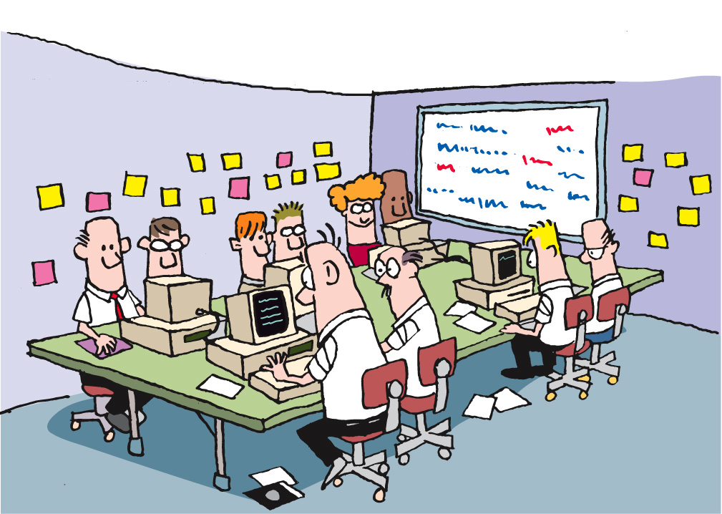
Face-to-face communication
Notes:
The most efficient and effective method of conveying information to and within a development team is face-to-face communication

Slide 17
Cross Team Communication
Team 1 Iteration Manager | Team 2 Iteration Manager | Team 3 Iteration Manager | IM Huddle
Tech Lead | Tech lead | Tech Lead | Tech Huddle
Business Analyst | Business Analyst | Business Analyst | BA Huddle
Tester | Tester | Tester | QA Huddle
Developer | Developer | Developer | Learning Lunches and Patterns
Notes:
Low: 1 minutes
High: 2 minutes

Slide 18
Sustainable Pace
Notes:
Agile processes promote sustainable development. Sponsors, developers, users, should be able to maintain a constant pace indefinitely.

Slide 19
Velocity
Points
Time (iterations)
Notes:
We really want a consistent delivery pace, so we can have some consistency and predictability about the project. Of course, there will be changes for people out sick, vacation, etc., but as leaders we need to do all we can to achieve a sustainable pace.

Slide 20
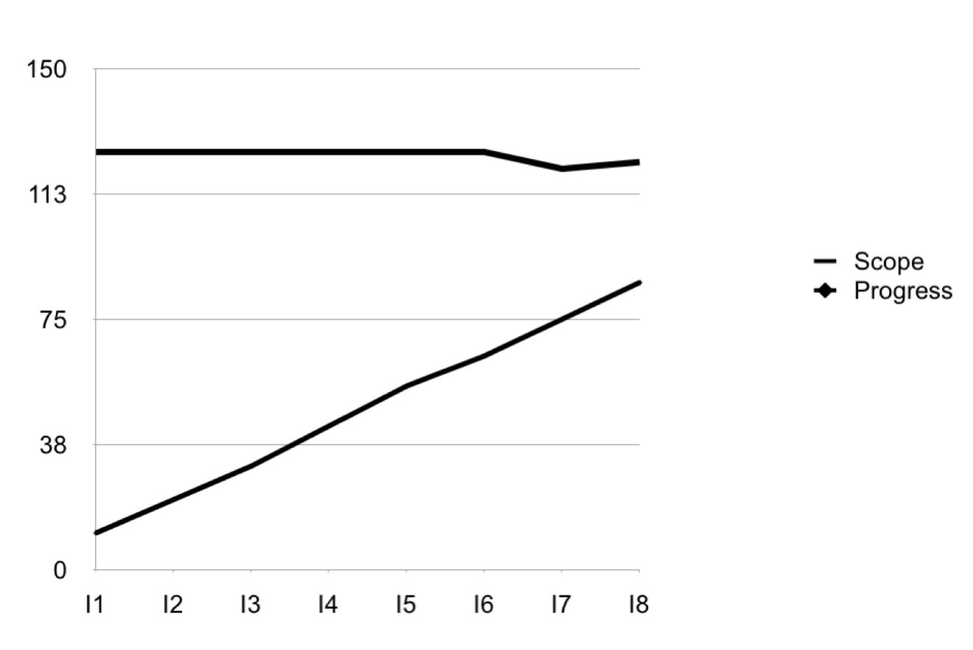
Velocity
Notes:
This allows us to track velocity to understand how much work the team can get done, and make reasonable predictions about completing the project.

Slide 21
Just Have Them Work More
Add Sunday
Add Saturday
Velocity
Time (iterations)
Notes:
This is from a large (300 person) project I was involved with a couple of years ago (Ellarby). The project was behind, primarily due to the IT Executive team accepting more features than they knew could be delivered.
Added Saturday as a “normal” workday through the end of the project (2-week iterations – 4 months). Velocity increased, but quickly dropped-off for only a 10% increase in velocity.
Added Sunday “just through the end of the project” – 2 months.
Velocity increased immediately, but again decreased over time.
By adding 2 days (40% increase in capacity) they accomplished a 15% increase in velocity.

Slide 22
Quality
Notes:
Continuous attention to technical excellence and good design enhances quality.

Slide 23

Everyone’s responsibility
Unit tests
Acceptance criteria
Refactoring
Code quality metrics

Slide 24
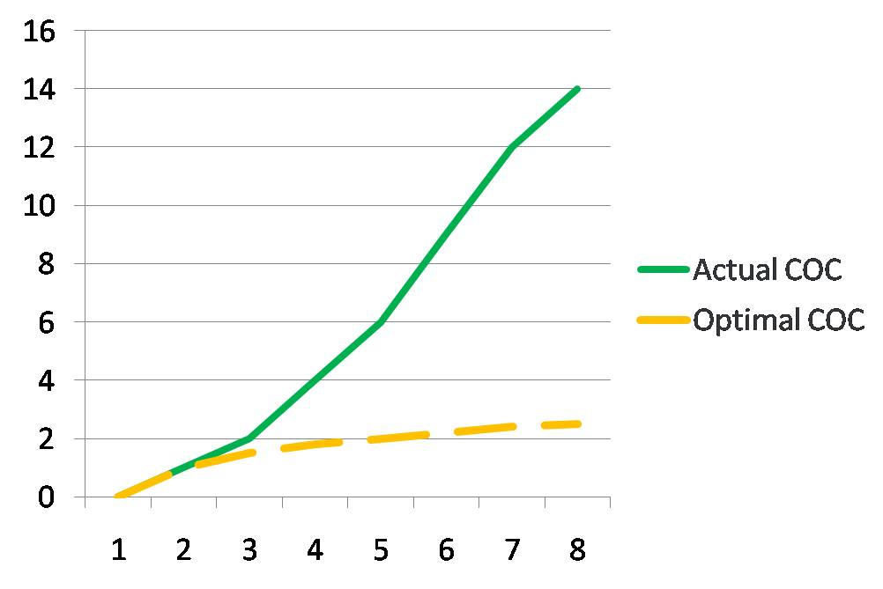
Cost of Change
TD
Cost of code change
Development time
Testing time
Error location
Error feedback ratio
Years
Notes:
With TD, the cost of change is increased.
What increases is: Development time, Testing time, Error location, Error feedback ration
The concept of Optimal cost of code change is a unquantifiable one within teams, but Agile practices all attempt to drive down the Actual cost of change towards the Optimal one.
Be aware that this cost of change is not tied specifically to pure development, but will impact analysis, testing and defect removal as well.

Slide 25
Continuous Improvement
Notes:
Continuous attention to technical excellence and good design enhances quality.

Slide 26
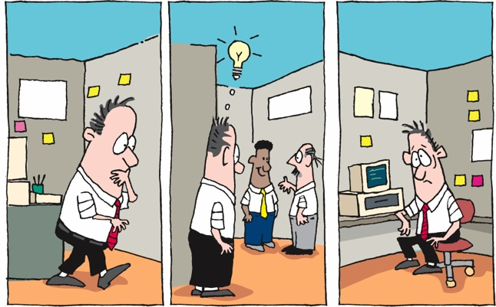
Waste
Notes:
Simplicity – the art of maximizing the amount of work not done – is essential.
JIT – requirements
Evolutionary design

Slide 27
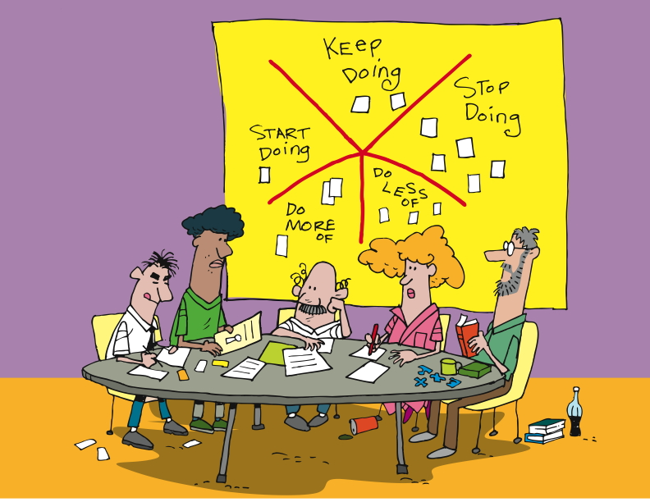
Retrospective
Held at end of an iteration, release, project.
Focused on improvement
Key part of Agile team culture
Notes:
...a meeting held by a project team at the end of a project or process (often after an iteration) to discuss what was successful about the project or time period covered by that retrospective, what could be improved, and how to incorporate the successes and improvements in future iterations or projects.
In agile development retrospectives play a very important role in iterative and incremental development. At the end of every iteration a retrospective is held to look for ways to improve the process for the next iteration.

Slide 28
The Process
Notes:
Let’s look high level at the overall process.
We’ll go into detail about each of these phases later on.

Slide 29

Agile project lifecycle (TW style)
Initiation
(Iteration 0)
Evolve / Handover (…)
Inception
Develop & deploy
Notes:
There is planning – Inception
2 – 4 weeks for a 4 – 6 month project
Flows, scenarios, stories
We need to prepare for Development – Initiation
Environment(s) set up
Narrative writing
Team processes
Develop & Deploy
Release working software
About 12 weeks of work
Common question?? How do I know how big the project is to determine how much time for Inception?
There has been a ‘Conceptualizing’ phase hopefully.
Experience. Relative sizing to other projects you’ve done.

Slide 30

Agile project lifecycle (TW style)
Many time-boxed iterations
Develop & deploy
Notes:
1 – 4 weeks
Shorter - more frequent change and increase transparency into issues and progress
Longer - accommodate the communication overhead required for larger, multi-team projects
Called a Release

Slide 31
The basics still apply
Analyze
Design
Code
Test
Deploy
Notes:
Repeating cycles of this stuff

Slide 32
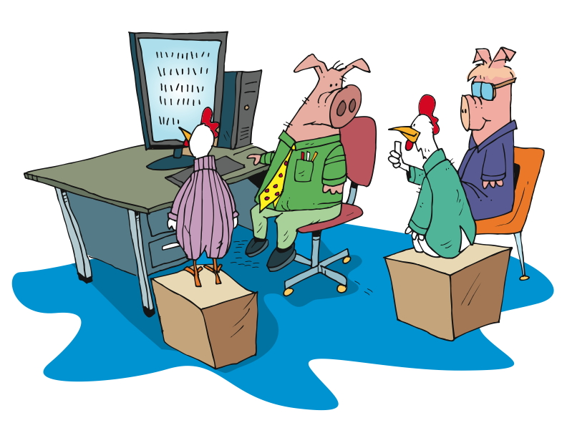
Feedback
Working software showcased to the business
Develop & deploy
Notes:
Talk about UAT – psychologically, people want to “kick the tires”

Slide 33
The flow
Daily stand-up
Story backlog
Prioritized subset
prepared for IKO
Iteration Kick-Off (IKO)
Showcase
Working software
Notes:
Story Backlog
List of stories for the entire project
Prioritized sub set
Prioritized for the next Iteration
Whole team
IPM
No waste
IKO
Clarify
Task
Estimate
Stand up
Short
Yesterday, today, blockers
Chickens and pigs
Showcases
Present working software
Sometimes give customer a play environment too
Customer gives feedback
New stories?
Re-plan?
Retrospective
Well, not so well
Constant improvement

Slide 34
The Team
Notes:
Who does what on an Agile team.

Slide 35








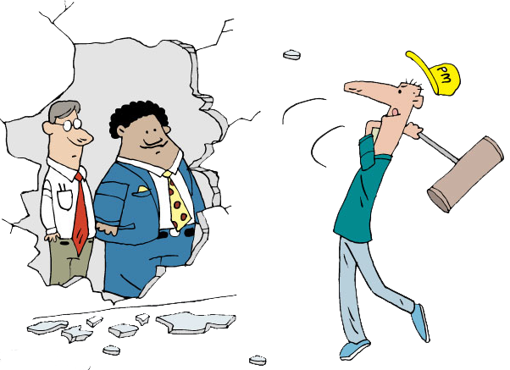
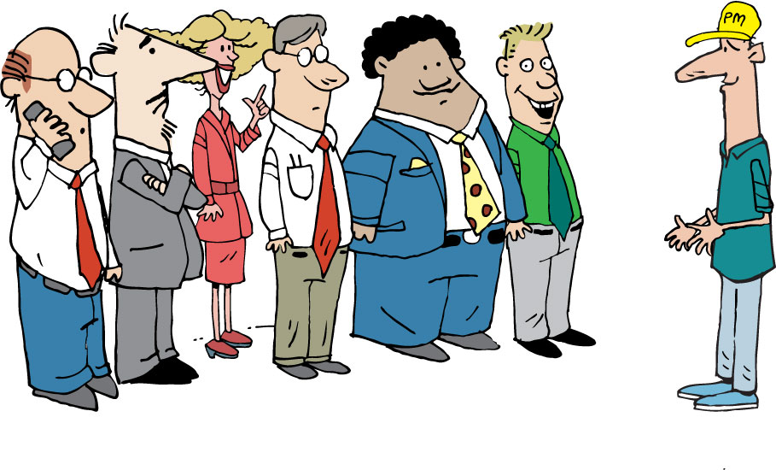





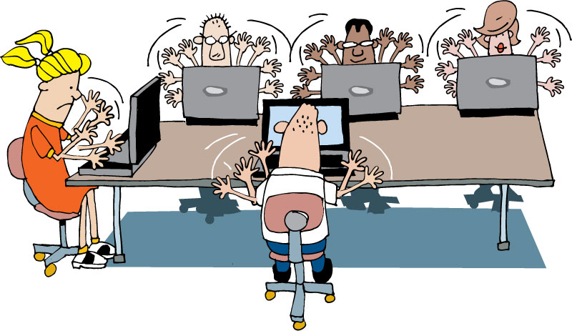


Indicative Team Composition
Extended
Team
Architects, Process Specialists and SMEs
Security Architect
Agile
Project
Team
Program Manager
Coach
Infrastructure Delivery Mgr.
Architect
Tech Lead
Product Owner
IM
Project Stakeholder Board
Business
Analyst
PM
Tester
UX Designer
Project Owner / Sponsor
Developer
Core
Team
Other Business Representatives
Operations, Integration & Support
Database Administrator
Notes:
Finally, the coach, who is effectively outside of it all, looking in and helping the extended team to avoid pitfalls and figure out how to reach high performance and achieve success.

Slide 36
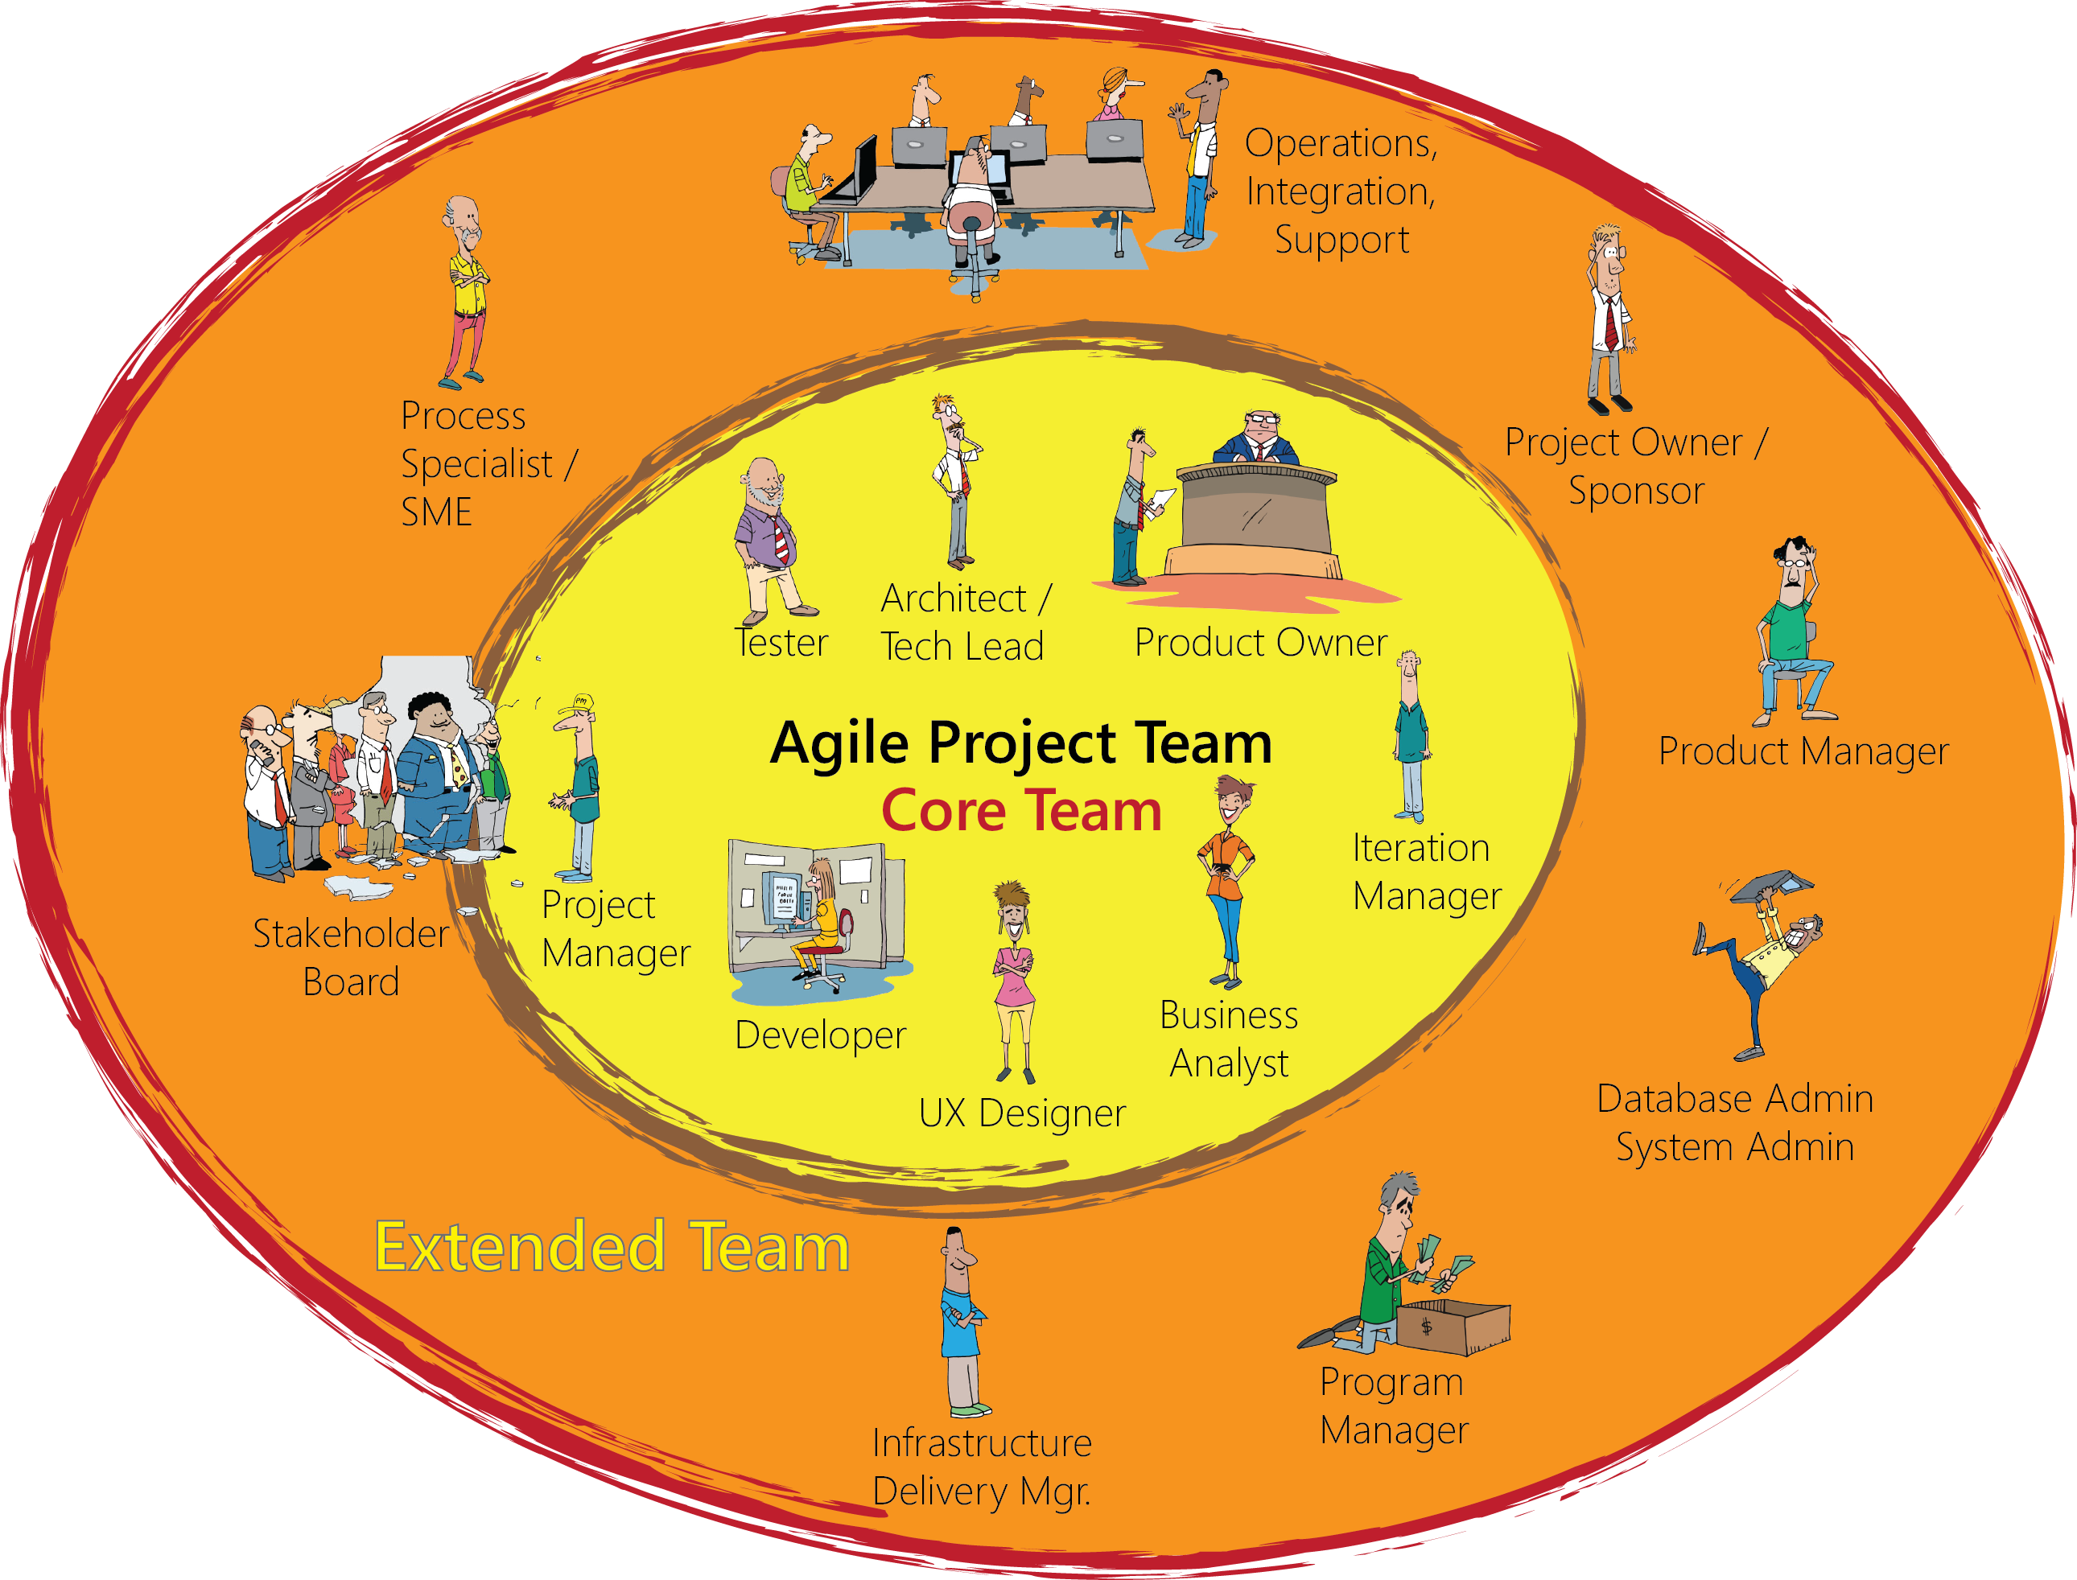

Indicative Team Composition
Notes:
Finally, the coach, who is effectively outside of it all, looking in and helping the extended team to avoid pitfalls and figure out how to reach high performance and achieve success.

Slide 37

Product Owner/Customer
Provides vision for the solution
Single point of escalation for prioritization
Defines ‘Done’
Responsible for ROI
Gives the business view

Slide 38

Iteration Manager / Scrum Master
Facilitates collaborative activity
Encourages and mentors
Carries water
Removes boulders
Notes:
PM is generally outward/management facing.
Budget to actuals
Steering committee, sponsor communication/meetings
Removes technical or resource obstacles
IM –[CLICK] Iteration Manager/Scrum Master can be a different person or the same person as the PM
is generally inward/team facing.
Facilitates team meetings – standups, IPM/IKO, retrospectives, showcase (w BA)
Tracks velocity, capacity
Manages the backlog. Works with customer and BA to prioritize new stories
Maintains card wall and other project radiators

Slide 39

Business Analyst
Facilitates workshops
Understands the business needs
Focuses on business value
Manages requirements
Creates artifacts
Supports developers
Works with testers
Notes:
#1 responsibility is to truly understand the business needs, problems and..
Work with developers to propose solutions.
Facilitates sessions with business and stakeholders
Requirements gathering
Prioritization
Showcases
Requirements elicitation, elaboration,
Creates stories and development artifacts
Writes acceptance criteria with the business/customer and QA
Works with developers and testers to clarify stories

Slide 40

User Experience Analyst
Facilitates workshops
Defines usability
Conducts usability testing
Usability =
Learnability
Efficiency
Memorability
Errors
Satisfaction
Notes:
Facilitates sessions to design the most ‘usable’ design for all users
Considers different roles, users
Usability is defined by 5 quality components:
Learnability
Efficiency
Memorability
Errors
Satisfaction

Slide 41

Developer
Creates working software
Adheres to coding standards
Practices TDD
Collaborates with BA and Testers
Notes:
Coding standards:
Consistent style and format for source code, either standard conventions specified by the language vendor (e.g. The Code Conventions for the Java Programming Language, recommended by Sun) or custom defined by the team
Design patterns (avoid anti-patterns) and principles, such as SOLID

Slide 42

Quality Assurance Analyst (Tester)
Informs ‘Done’
Creates test plans
Performs various tests
Updates quality metrics

Slide 43

Project Manager
The Agile PM focuses out
Responsible for Budget & Staffing
Coordinating with external teams and stakeholders
Notes:
Bottom line, PM is outward facing.
Supporting teams – environments, deployments, data, documentation,
Stakeholders
Executive or Steering committees
Low: 1 min
High: 3 min

Slide 44

Business Stakeholders
Represents a particular area of the business
Participates in key activities
Responds promptly
Notes:
Represents a particular area of the business (e.g. sales / marketing, legal / compliance, etc.) during the lifetime of the project
Participates in key activities, e.g. inception, release planning, showcases, etc.

Slide 45



Implementation Stakeholders
Represents areas of the delivery team
Participates in key activities
Responds promptly
Notes:
Represents a particular area of the wider delivery team (e.g. Operations)
Participates in key activities, e.g. inception, release planning, showcases, etc.

Slide 46
Questions?
Notes:
What we’ve done……
Seen how best practices address traditional project challenges
Learned the process
Met the team

